Slide 1
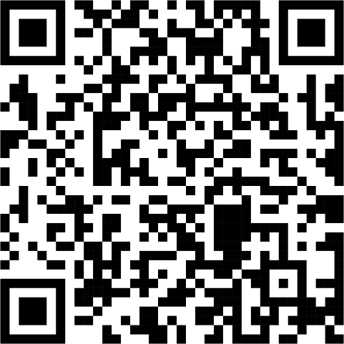
Scan the QR Code and watch the “Thank you, United Women in Faith” video
https://www.youtube.com/watch?v=Jc4dDMwoWK8

Slide 3
United Women in Faith - 101
ENTER LEADER’S NAME HERE

Slide 4
Agenda
Introduction
Who
What
When
Where
Why
Summary

Slide 5
Introduction

Slide 6
Who

Slide 7
Who are we?
United Women in Faith is a Community of women whose PURPOSE is to know God and to experience freedom as whole persons through Jesus Christ; To develop a creative, supportive fellowship; and to expand concepts of mission through participation in the global ministries of the church.
Those interested in discovering the world around us
Those interested in discovering Social Justice issues
Those interested in discovering the world by reading
Those interested in discovering the world by acting on what we’ve learned

Slide 8
What

Slide 9
What do we do?
Educate
Validate
March
Write
Encourage
Study
Give
Help
Notes:
Educate - Mission u, reading program,
Validate - everyone has a voice, a place at the table
March - Ubuntu days, Assembly, Jusisdictional events -
Write - letters, postcards, to congressman, schools, etc
Encourage - Each other, leaders
Study – Mission u, LDDs, Assembly
Give - Millions of dollars
Help - In anyway you would like

Slide 10
Mission u
Notes:
Study Leaders - Ed Zeiders, Kathy Nelson-Taylor

Slide 11
When

Slide 12
When do we act?
When the need arises
When something touches our hearts
When those around us can’t

Slide 13
Where

Slide 14
Where do we help?
Nearly 90 projects and community institutions support today’s vital needs across the United States.
United Women in Faith continues supporting and empowering local women in more than 50 countries around the globe to be leaders in the church, community, and the world.
Locally where the unit feels called.

Slide 15
Why

Slide 16
Why do we do it?
To help the marginalized
Because it is Scripture led – to help the least of these
Your reason goes here…

Slide 17
Our Purpose
“ United Women in Faith is a Community of women whose PURPOSE is to know God and to experience freedom as whole persons through Jesus Christ; To develop a creative, supportive fellowship; and to expand concepts of mission through participation in the global ministries of the church. ”

Slide 18
Thank you
Enter Presenter’s Name

Slide 19
For More Information:
Contact:
Enter Additional Contact Information
Or:
Enter Additional Contact Information
Or any of the many UWF members sitting near you.
Notes:
Goals:
By the end of this workshop members will:
Understand why changes are underway in our organization, including our taking the name United Women in Faith
Be familiar with new and improved programs and brand refreshment being launched in 2022.
Understand why changes are underway
Relate Jesus’ use of the new wineskins metaphor in Mark 2:21-22 to changes coming to our organization
Increase members awareness of the impact of change.
Claim our role as influencers inviting new women to the organization, at this exciting and pivotal time, as the optimal choice for women seeking a faith-based community of women that is inclusive, spiritually nurturing, and socially relevant.

Slide 20
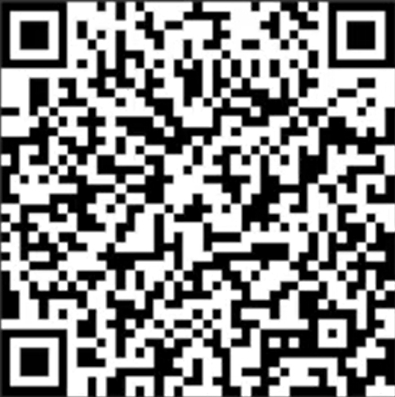
We want to know:
Does Your Church Have a
United Women in Faith Unit/Group/Circle?
Scan the QR Code &
Complete the survey!
Notes:
Hello everyone!
Let's dive in.
Welcome to the PAG Advisory Group meeting! My name is _______. And I'm join by my co-lead _______.
We want to begin with brief introductions. This is a chance for everyone to quickly share your name, conference, town and state, so we can all get familiar with who is who in the room and the unique perspectives we each bring.

